Slide 1


HTML5 Basics
Smart DevNet DevDay Bacolod
October 24, 2012
Ronald L. Ramos

Slide 2

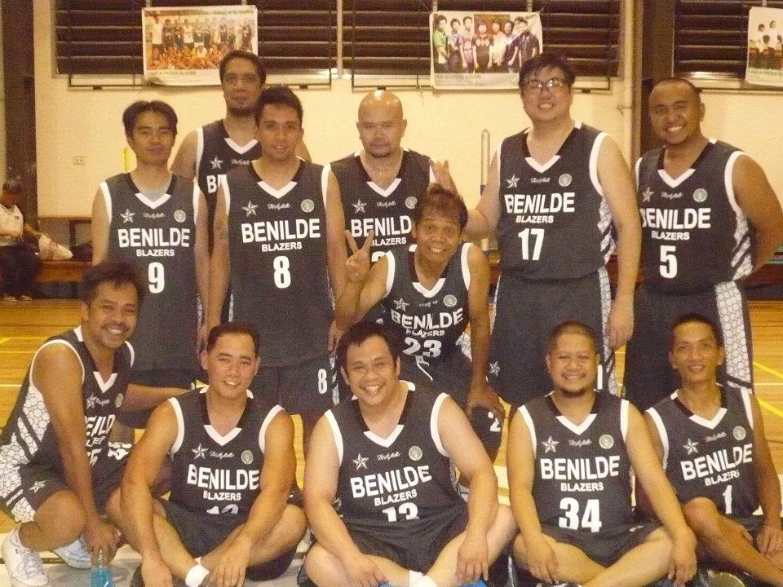
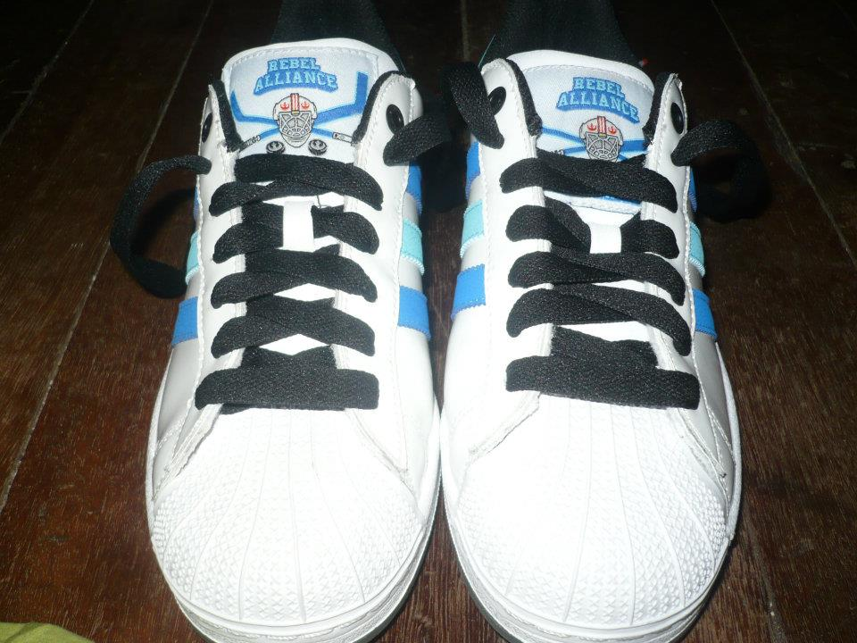


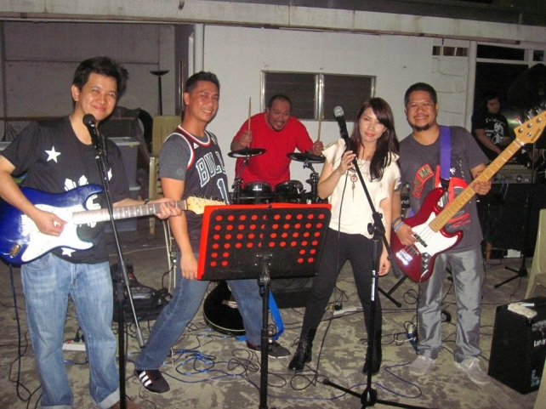

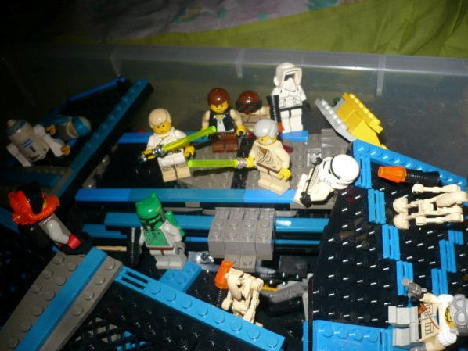
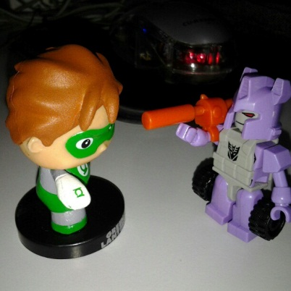
About me briefly
Blue With Envy

Slide 3
Files
https://github.com/taleweaver

Slide 4
What is HTML5?

Slide 5
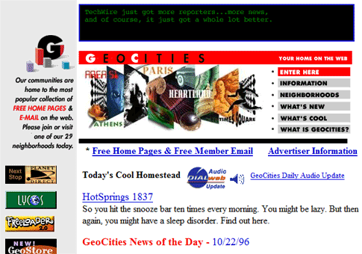

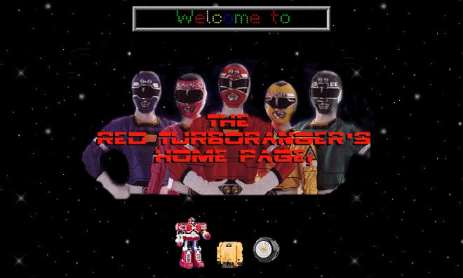
A bit of history

Slide 6
What is HTML5?
HTML5 will be the new standard for HTML.
The previous version of HTML, HTML 4.01, came in 1999. The web has changed a lot since then.
HTML5 is still a work in progress. However, the major browsers support many of the new HTML5 elements and APIs.

Slide 7
How Did HTML5 Get Started?
HTML5 is a cooperation between the World Wide Web Consortium (W3C) and the Web Hypertext Application Technology Working Group (WHATWG).
WHATWG was working with web forms and applications, and W3C was working with XHTML 2.0. In 2006, they decided to cooperate and create a new version of HTML.
Some rules for HTML5 were established:
New features should be based on HTML, CSS, DOM, and JavaScript
Reduce the need for external plugins (like Flash)
Better error handling
More markup to replace scripting
HTML5 should be device independent
The development process should be visible to the public

Slide 8
The HTML5 <!DOCTYPE>
In HTML5 there is only one <!doctype> declaration, and it is very simple:
<!DOCTYPE html>
Contrast HTML 4’s doctype: <!DOCTYPE HTML PUBLIC "-//W3C//DTD HTML 4.01 Transitional//EN" "http://www.w3.org/TR/html4/loose.dtd">

Slide 9
Minimum HTML5 Document
Below is a simple HTML5 document, with the minimum of required tags:
<!DOCTYPE html> <html> <head> <title>Title of the document</title> </head> <body> The content of the document...... </body> </html>

Slide 10
Where to start?
Templates
http://html5boilerplate.com/
http://html5reset.org/
Books
http://www.abookapart.com/products/html5-for-web-designers
The official specifications:
http://dev.w3.org/html5/spec-author-view/spec.html

Slide 11
New Elements

Slide 12
New Semantic/Structural Elements
Tag | Description
<article> | Defines an article
<aside> | Defines content aside from the page content
<bdi> | Isolates a part of text that might be formatted in a different direction from other text outside it
<command> | Defines a command button that a user can invoke
<details> | Defines additional details that the user can view or hide
<summary> | Defines a visible heading for a <details> element
<figure> | Specifies self-contained content, like illustrations, diagrams, photos, code listings, etc.
Notes:
HTML5 offers new elements for better structure.

Slide 13
New Semantic/Structural Elements
Tag | Description
<figcaption> | Defines a caption for a <figure> element
<footer> | Defines a footer for a document or section
<header> | Defines a header for a document or section
<hgroup> | Groups a set of <h1> to <h6> elements when a heading has multiple levels
<mark> | Defines marked/highlighted text
<meter> | Defines a scalar measurement within a known range (a gauge)
<nav> | Defines navigation links
<progress> | Represents the progress of a task

Slide 14
New Semantic/Structural Elements
Tag | Description
<ruby> | Defines a ruby annotation (for East Asian typography)
<rt> | Defines an explanation/pronunciation of characters (for East Asian typography)
<rp> | Defines what to show in browsers that do not support ruby annotations
<section> | Defines a section in a document
<time> | Defines a date/time
<wbr> | Defines a possible line-break

Slide 15
New Media Elements
Tag | Description
<audio> | Defines sound content
<video> | Defines a video or movie
<source> | Defines multiple media resources for <video> and <audio>
<embed> | Defines a container for an external application or interactive content (a plug-in)
<track> | Defines text tracks for <video> and <audio>
Notes:
HTML5 offers new elements for media content.

Slide 16
The new <canvas> Element
Tag | Description
<canvas> | Used to draw graphics, on the fly, via scripting (usually JavaScript)

Slide 17
New Form Elements
Tag | Description
<datalist> | Specifies a list of pre-defined options for input controls
<keygen> | Defines a key-pair generator field (for forms)
<output> | Defines the result of a calculation
Notes:
HTML5 offers new form elements, for more functionality.

Slide 18
New Semantic/Structural Elements
<html>
<!doctype html>
<head><title>New HTML Tags</title></head>
<body>
<h1>My Favorite Things</h1>
<section>
<h2>Hobbies</h2>
<h3>Lego</h3>
<p>I've had these building bricks since I was 3. They are amazing.</p>
<h3>Gunpla</h3>
<p>Model kits. Plastic Model kits. Only instead of tanks and planes I prefer robots</p>
<h3>Comics</h3>
<p>My favorite is Green Lantern. And then most of the DC Heroes. I also like Marvel.</p>
</section>
</body>
</html>

Slide 19
New Form Elements
<html>
<!doctype html>
<head><title>New HTML Tags</title></head>
<body>
<form>
Email Address: <input type="email" name="email" required placeholder="Enter a valid email
address"><br>
Website: <input type="url" name="website" required pattern="https?://.+"><br>
Age: <input type="number" size="6" name="age" min="18" max="99" value="21"><br>
Satisfaction: <input type="range" size="2" name="satisfaction" min="1" max="5" value="3"><br>
<input type="submit">
</form>
</body>
</html>
Notes:
http://www.the-art-of-web.com/html/html5-form-validation/

Slide 20
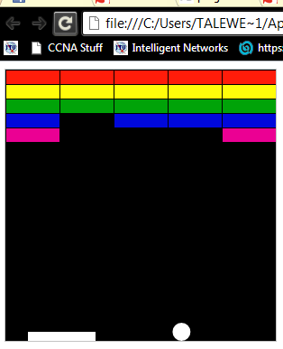
The Canvas
<html>
<!doctype html>
<head><title>Canvas</title></head>
<body>
<canvas id="myCanvas" width="578" height="200"></canvas>
<script>
var canvas = document.getElementById('myCanvas');
var context = canvas.getContext('2d');
// round line cap (middle line)
context.beginPath();
context.moveTo(200, canvas.height / 2);
context.lineTo(canvas.width - 200, canvas.height / 2);
context.lineWidth = 20;
context.strokeStyle = '#0000ff';
context.lineCap = 'round';
context.stroke();
</script>
</body>
</html>

Slide 21
Removed Elements
The following HTML 4.01 elements are removed from HTML5:
<acronym>
<applet>
<basefont>
<big>
<center>
<dir>
<font>
<frame>
<frameset>
<noframes>
<strike>
<tt>

Slide 22
A Sample App

Slide 23
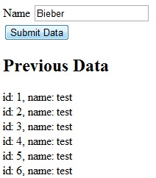
Data Entry Form
<body>
<form method="get" id="dataform">
<div>
<label for="fname">Name</label>
<input type="text" placeholder="Enter Name" id="fname"
name="fname" required=required />
</div>
<div>
<input type="submit" value="Submit Data" />
</div>
</form>
<div>
<h2>Stored Data</h2>
</div>
<div id="previous_info">
</div>
</body>
Notes:
Complete Code:
<!DOCTYPE html>
<html>
<head>
<title>Employee Info</title>
<script src="http://www.google.com/jsapi"></script>
<script>
google.load("jquery", "1.4.1");
</script>
</head>
<body>
<form method="get" id="dataform">
<div>
<label for="fname">Name</label>
<input type="text" placeholder="Enter Name" id="fname" name="fname" required=required />
</div>
<div>
<input type="submit" value="Submit Data" />
</div>
</form>
<div>
<h2>Stored Data</h2>
</div>
<div id="previous_info">
</div>
</body></html>

Slide 24
Adding JQuery
<head>
<title>Save My Name</title>
<script src="http://www.google.com/jsapi"></script>
<script>
google.load("jquery", "1.4.1");
</script> <head>
<title>Save My Name</title>
<script src="http://www.google.com/jsapi"></script>
<script>
google.load("jquery", "1.4.1");
</script>
</head>
Notes:
Adding JQuery to your site:
http://think2loud.com/576-jquery-101-adding-jquery-to-your-website/

Slide 25
Create a Database
var db = window.openDatabase("InfoDB", "1.0", "My Info", 1024*1000);
Notes:
The four arguments: Database name, Version number, Database display name, max size in bytes
Code:
<!DOCTYPE html>
<html>
<head>
<title>Save My Name</title>
<script src="http://www.google.com/jsapi"></script>
<script>
google.load("jquery", "1.4.1");
</script>
<script>
var db = window.openDatabase("InfoDB", "1.0", "My Info", 1024*1000);
</script>
</head>
<body>
<form method="get" id="dataform">
<div>
<label for="fname">Name</label>
<input type="text" placeholder="Enter Name" id="fname”
name="fname" required=required />
</div>
<div>
<input type="submit" value="Submit Data" />
</div>
</form>
<div>
<h2>Stored Data</h2>
</div>
<div id="previous_info">
</div>
</body>
</html>

Slide 26
Creating the Table
$(document).ready(function() {
db.transaction(function(tx) {
tx.executeSql('CREATE TABLE IF
NOT EXISTS Info(id INTEGER PRIMARY KEY,
fname TEXT)', []);
});
Notes:
Code:
<!DOCTYPE html>
<html>
<head>
<title>Save My Name</title>
<script src="http://www.google.com/jsapi"></script>
<script>
google.load("jquery", "1.4.1");
</script>
<script>
var db = window.openDatabase("InfoDB", "1.0", "My Info", 1024*1000);
$(document).ready(function() {
db.transaction(function(tx) {
tx.executeSql('CREATE TABLE IF NOT EXISTS Info(id INTEGER PRIMARY KEY, fname TEXT)', []);
});
</script>
</head>
<body>
<form method="get" id="dataform">
<div>
<label for="fname">Name</label>
<input type="text" placeholder="Enter Name" id="fname”
name="fname" required=required />
</div>
<div>
<input type="submit" value="Submit Data" />
</div>
</form>
<div>
<h2>Stored Data</h2>
</div>
<div id="previous_info">
</div>
</body>
</html>

Slide 27
Insert Data
function insertData(fname) {
db.transaction(function(tx) {
tx.executeSql('INSERT INTO Info(fname) VALUES (?)', [fname]);
});
}
Notes:
Code:
<!DOCTYPE html>
<html>
<head>
<title>Save My Name</title>
<script src="http://www.google.com/jsapi"></script>
<script>
google.load("jquery", "1.4.1");
</script>
<script>
var db = window.openDatabase("InfoDB", "1.0", "My Info", 1024*1000);
function insertData(fname) {
db.transaction(function(tx) {
tx.executeSql('INSERT INTO Info(fname) VALUES (?)', [fname]);
});
}
$(document).ready(function() {
db.transaction(function(tx) {
tx.executeSql('CREATE TABLE IF NOT EXISTS Info(id INTEGER PRIMARY KEY, fname TEXT)', []);
});
});
</script>
</head>
<body>
<form method="get" id="dataform">
<div>
<label for="fname">Name</label>
<input type="text" placeholder="Enter Name" id="fname”
name="fname" required=required />
</div>
<div>
<input type="submit" value="Submit Data" />
</div>
</form>
<div>
<h2>Stored Data</h2>
</div>
<div id="previous_info">
</div>
</body>
</html>

Slide 28
Display Data
function renderResults(tx, rs) {
e = $('#previous_info');
e.html("");
for(var i=0; i < rs.rows.length; i++) {
r = rs.rows.item(i);
e.html(e.html() + 'id: ' + r['id'] + ', name: ' + r['fname'] + '<br />');
}
}
function renderData() {
db.transaction(function(tx) {
tx.executeSql('SELECT * FROM Info', [], renderResults);
});
}
Notes:
Code:
<!DOCTYPE html>
<html>
<head>
<title>Save My Name</title>
<script src="http://www.google.com/jsapi"></script>
<script>
google.load("jquery", "1.4.1");
</script>
<script>
var db = window.openDatabase("InfoDB", "1.0", "My Info", 1024*1000);
function insertData(fname) {
db.transaction(function(tx) {
tx.executeSql('INSERT INTO Info(fname) VALUES (?)', [fname]);
});
}
function renderResults(tx, rs) {
e = $('#previous_info');
e.html("");
for(var i=0; i < rs.rows.length; i++) {
r = rs.rows.item(i);
e.html(e.html() + 'id: ' + r['id'] + ', name: ' + r['fname'] + '<br />');
}
}
function renderData() {
db.transaction(function(tx) {
tx.executeSql('SELECT * FROM Info', [], renderResults);
});
}
$(document).ready(function() {
db.transaction(function(tx) {
tx.executeSql('CREATE TABLE IF NOT EXISTS Info(id INTEGER PRIMARY KEY, fname TEXT)', []);
});
</script>
</head>
<body>
<form method="get" id="dataform">
<div>
<label for="fname">Name</label>
<input type="text" placeholder="Enter Name" id="fname”
name="fname" required=required />
</div>
<div>
<input type="submit" value="Submit Data" />
</div>
</form>
<div>
<h2>Stored Data</h2>
</div>
<div id="previous_info">
</div>
</body>
</html>

Slide 29
Submit Data
$(document).ready(function() {
db.transaction(function(tx){
tx.executeSql('CREATE TABLE IF NOT EXISTS Info(id INTEGER PRIMARY KEY, fname TEXT)', []);
});
$('#dataform').submit(function() {
insertData($('#fname').val());
renderData();
return false;
});
renderData();
});
Notes:
Code:
<!DOCTYPE html>
<html>
<head>
<title>Save My Name</title>
<script src="http://www.google.com/jsapi"></script>
<script>
google.load("jquery", "1.4.1");
</script>
<script>
var db = window.openDatabase("InfoDB", "1.0", "My Info", 1024*1000);
function insertData(fname) {
db.transaction(function(tx) {
tx.executeSql('INSERT INTO Info(fname) VALUES (?)', [fname]);
});
}
function renderResults(tx, rs) {
e = $('#previous_info');
e.html("");
for(var i=0; i < rs.rows.length; i++) {
r = rs.rows.item(i);
e.html(e.html() + 'id: ' + r['id'] + ', name: ' + r['fname'] + '<br />');
}
}
function renderData() {
db.transaction(function(tx) {
tx.executeSql('SELECT * FROM Info', [], renderResults);
});
}
$(document).ready(function() {
db.transaction(function(tx){
tx.executeSql('CREATE TABLE IF NOT EXISTS Info(id INTEGER PRIMARY KEY, fname TEXT)', []);
});
$('#dataform').submit(function() {
insertData($('#fname').val());
renderData();
return false;
});
renderData();
});
</script>
</head>
<body>
<form method="get" id="dataform">
<div>
<label for="fname">Name</label>
<input type="text" placeholder="Enter Name" id="fname”
name="fname" required=required />
</div>
<div>
<input type="submit" value="Submit Data" />
</div>
</form>
<div>
<h2>Stored Data</h2>
</div>
<div id="previous_info">
</div>
</body>
</html>

Slide 30
Quick summary
HTML5 = HTML + JavaScript + CSS
New form elements allow for better forms
Local storage via SQLite

Slide 31

Thanks for listening!
Contact Info:
eMail: rlramos@smart.com.ph
Mobile: 09298874076
Office #: 5113175
Facebook: rlramos@gmail.com

